Slide 1


Juan Jesús Ávila Mota
Academia Java Xideral
Examen Semana03

Slide 2
PROGRAM WITH JUnit

Slide 3
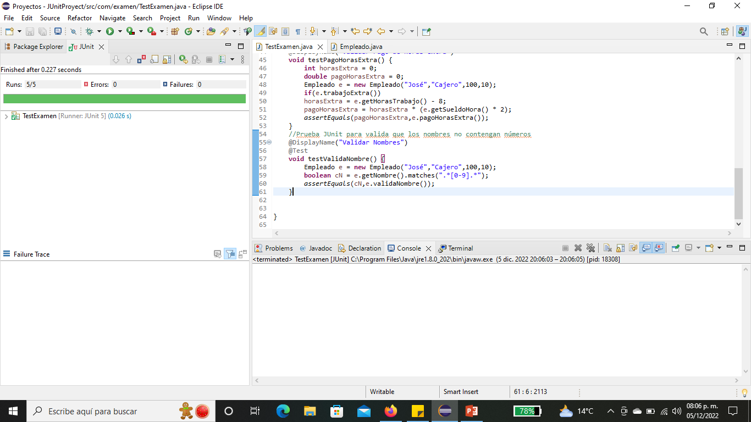

Slide 4
TDD was used in this program, that is, the JUnit tests were programmed first and later the class was created with its attributes and methods, where it is validated if the employee worked overtime and what was the payment for these hours which are paid to the double

